Slide 1
Clean Growth Choices Consortium
Pathways for Managing Rural and Regional Economic and Social Transitions
The Communities in Transition Case

Slide 2
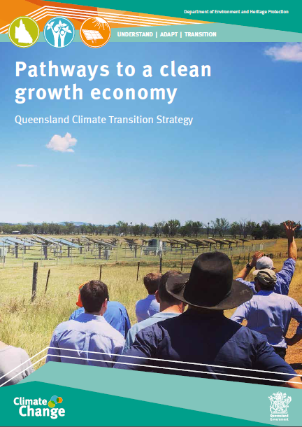
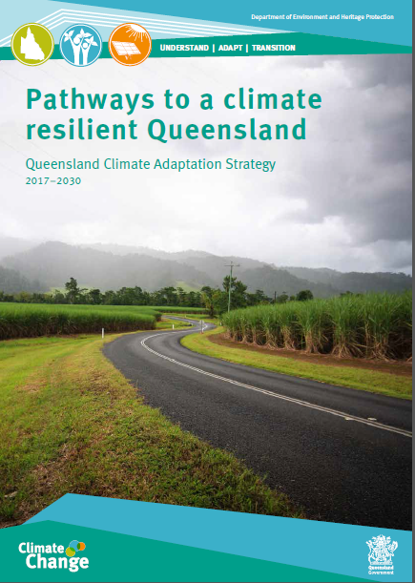
Clean Growth Choices for Communities in Transition Delivering
Understanding
Adaptation
Transition

Slide 3
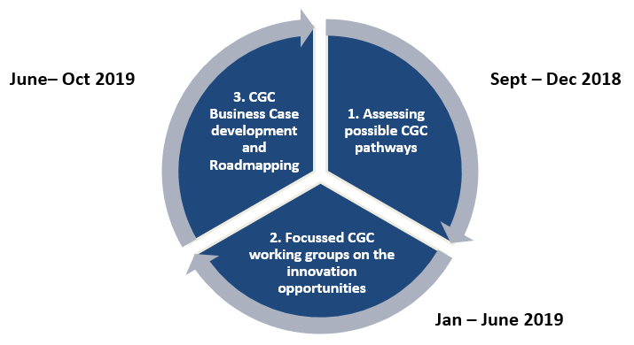
Communities in Transition - Three Key Steps

Slide 4
Some Big Pathways for Rockhampton Region……
Outward Bound: Major New Supply Chain Opportunity Through Airport Internationalisation
Making Rookwood Work: Preparing the Ground for Low Impact Ag, including biofuels
Flood Resilience: Major New Focus on Floodplain Management & Reef Ecosystems
Aquacultural Boom: Towards A Zero Emissions Aquaculture Sector
Pathways That Contribute to More Positive Scenarios
Tourism & Recreation Revival: Enviro, River, Historic, Indigenous
New Circular Economy: Turbo-Charging Support for Business-Based Economic and Eco-Efficiencies

Slide 5
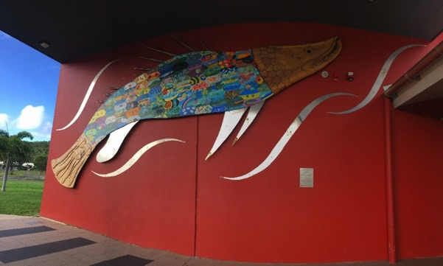
Emerging Business Case Outcomes in the Northern Regions
Dynamic Business Ventures - clear preferences for:
Building small business innovation & capacity
Strong cluster development in five sectors (including food).
(c) Planned and cooperative approaches to workforce and population
(d) Towards a longer term economic development structure
Making Water Work Clear preferences for:
Demand led approaches to supply chain vision
Visionary land use planning & infrastructure planning
More effective water governance and products
Exploring circular approaches to waste and energy
Next generation Reef protection

Slide 6
From Concept to Transformational Change
Concept Development Stage 1 - CiT Investment (DES) Resulting in Development of 18 Business Cases
Transformational Private Sector Investment
Stage 4 - Private Sector Investment (Small to Medium) Drives Transformational Economic, Social and Environmental Change
Local Capacity/ Planning to Drive Transformational Investment
Stage 2 - CiT Investment (Multiparty Partnership) to Deliver the Business Cases
Feasibility For Key Shared InfrastructureStage 3 – Building Private-Public Sector Partnerships to Deliver Enabling Infrastructure

Slide 7
Reflections on Implementation
Inspiring co-design from the start.
More sophisticated approaches to scenario building.
Resilience based thinking and language appears more suitable.
Improving and resourcing the system of governance in communities.
Practical and meaningful business cases that lead to adaptive actions.
Building relationship pathways into investment.
Recognizing and building upon existing momentum.
Role of critical third party in nudging and facilitation.
Strong linkages between business support (EcoBiz) and community.

Slide 8
Emerging Policy Implications
Regionalize emerging water and energy planning frameworks.
Support new agricultural development as circular economies.
Support for more resilient and value rich supply chains.
New approaches to next generation (transferable) workforce skills.
Stronger focus on establishing ecosystem services trading.
Major reform of the current governance system of floodplain planning.
Stronger and area based focus on lifting digital connectivity.
New approaches to lifting social and economic disaster resilience.
Cluster based approaches to supporting new sector opportunities.

