Slide 1
Environmental impact and environmental markets
Amelia Selles
Manager, Environmental Offsets Policy
Queensland Department of Environment and Science
October 2021

Slide 2
Presentation outline
Voluntary vs compliance environmental markets
Where do environmental offsets fit in?
What is the role of government?
Challenges and opportunities, what are we hearing?
How do we better support environmental markets in Queensland?
Notes:
Who I am within DES and what we do
What will cover in the presentation, noting this is for discussion purposes and intended to prompt thought and discussion, very keen to hear from attendees

Slide 3
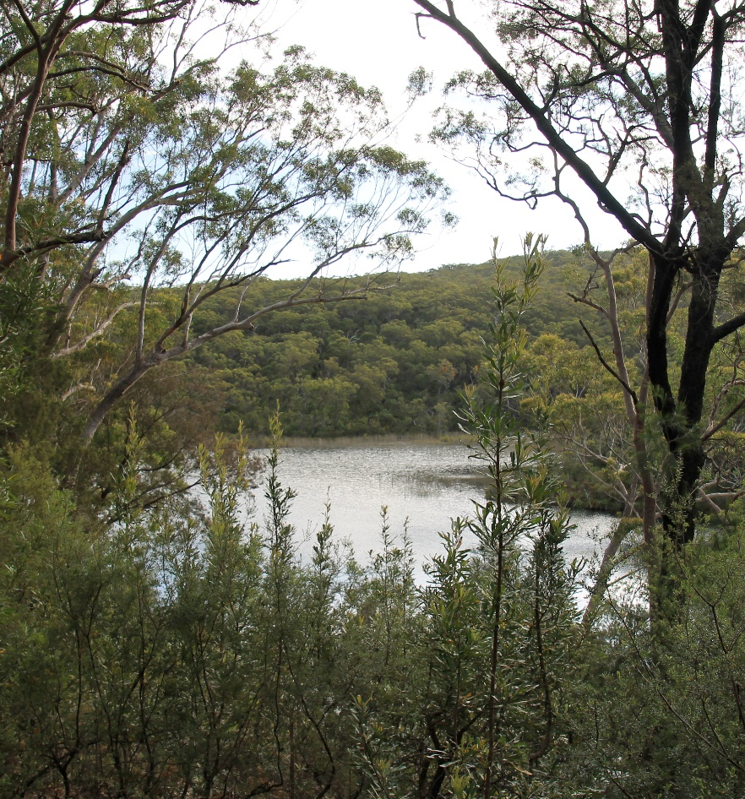
Presentation context
Australia ranks second in the world for biodiversity loss
Queensland is recognised globally as a hotspot for biodiversity
Notes:
According to a report by the Organisation for Economic Co-operation and Development
In Queensland 29 plants and animals are now extinct in the wild, and a further 245 animals and 784 plants are listed as threatened
Environmental markets and environmental offsets are part of the toolkit, they are not the only solution or answer., they are not the panacea, however they do have potential to bring much needed investment and attention into biodiversity conservation

Slide 4
Presentation context
High growth and interest in environmental markets
Confusion
Not uniform - many different ‘types’ of markets/approaches/motivations/participants…
Not one answer - pros and cons
Risk of poor or perverse outcomes
Fear of opportunity cost

Slide 5
Voluntary vs compliance environmental markets
One description used
Compliance markets – created by and in accordance with a regulatory obligation, more rigid
Voluntary markets – operate outside compliance markets and enable participation and ‘purchase’ on a voluntary basis
But can be mixed….
Notes:
Range of different descriptions and classifications, no one size fits all
Different motivations, purposes, structures, participants etc
One description compliance and voluntary but can have elements of both

Slide 6
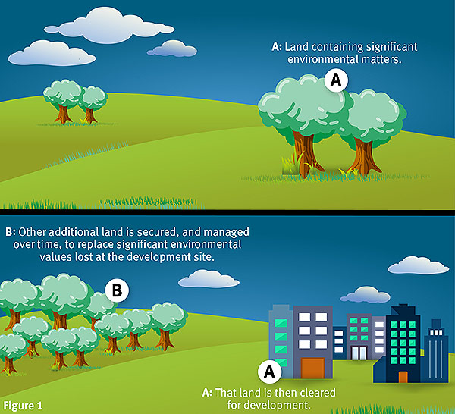
What is an environmental offset?
Compensate for unavoidable impacts on environmental matters
Applies to prescribed activities and matters
When a person or entity impacts important environmental values on a development site, may have to replace the loss by securing and managing the land at another site over a period of time
This protected and managed site is an environmental offset
Must achieve a conservation outcome
Notes:
Ecosystems can never be really replaced as the functions and characteristics are unique and impossible to replicate. The offset site provides similar values, such as habitat and species composition.
Not all impacts can be offset, only environmentally significant values, such as certain species and ecosystems

Slide 7
An environmental offset should never be the first option used to protect the environment at a development site
Developers must:
Avoid and minimise impacts
Rehabilitate the impact site (if applicable)
Deliver an offset for any unavoidable impacts that remain
Stop
Notes:
The priority should always be to protect the environmental values where they are at the impact site first.
Offsets are for unavoidable residual impacts (permanently lost or impacted)

Slide 8
How does an environmental offset site compensate for an impact?
Impact site
Unavoidable significant impacts on an important value, e.g. threatened species habitat
Offset site
Offset counterbalances the impacts by restoring similar environmental values so that there is no net loss
Notes:
The site must provide an outcome (habitat etc) for the same species that was impacted, or ecosystems similar to those impacted.
Note that similar is more accurate under our framework, e.g. REs/ including wetlands can currently be restored within the same BVG.
Environmental values are those listed by the government (matters of state environmental significance under Queensland legislation or matters of local environmental significance under local planning schemes)

Slide 9
How are offsets delivered
Offset conditions imposed by:
Commonwealth Government
Queensland Government
Local government
Under State framework developer meets conditions by:
Payment to local government or DES (“financial settlement offset”)
Deliver the offset on their land (“proponent-driven offset”)
Enter into a private agreement with a landholder (also “proponent-driven offset”)
Notes:
For financial settlement offsets required by a local government, an alternative financial settlement payment amount may be determined provided that the: • payment amount is no greater than what would have been required if calculated in accordance with the Financial Settlement Offset Calculation Methodology in Appendix 4; and • the local government is able to achieve a conservation outcome for the nature, size and scale of the impact on the prescribed environmental matter(s), the subject of the offset payment. When delivering offsets using financial settlement payments, local government may use money derived from other sources to supplement delivery of the conservation outcome where the financial settlement offset payment does not cover the full offset delivery costs.
The Offsets Act also provides that funds received by local governments for the purpose of environmental offsets must also be spent in a manner consistent with delivering a conservation outcome for the impacted matter. Financial payments made to local governments are held in a trust fund that is administered by the local government and may be used to pay for the offset delivery and fees associated with administering the fund.

Slide 10
Environmental offset market
An offset environmental market is created by the offset condition
The ‘buyer’ is the approval/permit holder of the offset condition, where the offset obligation is paid out financially, a government/body takes this role
The ‘seller/supplier’ is the landholder/manager of the offset site
Limits volume, location and focus for the market
Key issue is land supply for the offset site, can create time lag and can lead to compromised conservation outcomes

Slide 11
Advanced offsets
Land registered for future use as an offset
Reduce time delay and risks
Used by developers or government
No obligations until agreement to use
Competitive edge in offset tender processes run by State
Also ‘soft’ entry options - expression of interest
How do we link proponents with land supply e.g. advanced offsets, offsets register etc
Notes:
An area of land that may be used as an offset site to compensate for a future significant residual impact on an environmental matter.
Can reduce the time delay in finding a suitable offset site and associated project risks.
It is encouraged that landholders apply to register land to deliver offsets, especially if their land contains environmental matters in high demand for offsets, and in strategic locations.
There is no guarantee the landholder will be approached to enter into a formal offset agreement by a proponent.
Advanced offsets are listed on the public offsets register which proponents requiring and offset should consult.
Landholders with suitable sites can be identified and invited to participate in tenders for offset projects required by the offset fund.

Slide 12
Conservation banking and building a ‘restorative economy’
What can we learn from overseas examples?
Incentivising protection and restoration
Generate income for landholders and managers
Deliver conservation outcomes
Offset impacts
Notes:
Began, 70s, wetland mitigation banking in the 80s, 90sUS and UK examples
NSW and Victoria have banking schemes too 10 – 20 year progression, acceleration in last 5 years
More recent in Australia and different approach among the states
Mitigation bank – parcel of land protected in perpetuity with the aim of preserving, restoring and/pr enhancing ecological function….compensatory mitigation to offset the impacts on ecological values, once established the bank can be used to generate credit that can be sold to meet requirements
Restoration economy – economic activity based on repurposing, renewing and reconnecting natural, built and socioeconomic environments
Rewards and penalties associated with conservation
Advantages
Diversified income
Increased employment opportunities
Opportunities for First Nations peoples
Restoration and protection of values
Offset impacts
Commercial investment opportunities

Slide 13
Prof. Samuels review federal environment act
Market depth – ability for wide range of participants to purchase restoration for a range of reasons
Market integrity – transparency, clear standards, reporting and registers, monitoring, compliance and enforcement
Market efficiency – overhead costs low, buyers and sellers can easily find each other
Interim Report | Independent review of the EPBC Act (environment.gov.au)

Slide 14
Where does other investment fit in?
‘Impact’ investment and co-investment models
Recent and emerging trends in the private sector highlight potential for significant capital being invested in environmental outcomes globally
Principal drivers of change
climate risk disclosure
institutional investor and shareholder corporate social responsibility expectations and reputation
Trend towards accounting and reporting on credible, verified outcomes, robust and transparent

Slide 15
Role of government in environmental markets
Enable via policy and regulation
Support measurement and valuation
Improve responsiveness
Unlock supply at scale
Reduce complexity
Build capacity
Continued public funding (not everything can be funded through markets)
De-risking investments

Slide 16
Role of government in environmental offsets compliance market
Regulator
Enabler
Queensland environmental offsets reforms
A review of Queensland’s environmental offsets framework Consultation and Response Report (www.qld.gov.au)

Slide 17
Challenges and opportunities, what are we hearing?
Complex and unclear
Costs and benefits
Trust building
One size does not fit all
How do markets ‘fit’ together?
How do we assign value and measure?
Roles and responsibilities
Enablers – e.g. brokers?
Cross sectoral challenges
How do we encourage a ‘restorative economy’

Slide 18
How do we better support environmental markets in Queensland?
Communication and extension support?
Risk management and compliance?
Transparent decision making?
Roadmaps and strategies for Roadmaps, action plans and strategies for biodiversity and markets?
Easy to understand and use tools and guidelines?
Monitoring, evaluation, reporting?
Consideration of market players/structure/security?
Incentives and cost recovery?
Regulation and policy?

Slide 19
Queensland has significant advantages
iconic natural values, diverse and large state
opportunity for large-scale projects
stable economic and political position
Insight from experiences to-date….
Interest in where to from here….

Slide 20
Questions?
Email - offsets@des.qld.gov.au
Notes:
Non-Regulatory Reforms: The emphasis will be on supporting tools and guidelines that help functionality and use, align methodologies and streamline processes – significant residual impact guidelines, habitat quality guidelines, forms, templates and checklists, general guide, iLearns, offsets register data delivery.
Additionally, the non-regulatory reforms will provide the foundation for a market-based approach, e.g. linking landholders and proponents through advanced offsets and expression of interest.

Slide 21
Links to further reading and useful information
Environmental offsets | Environment, land and water | Queensland Government (www.qld.gov.au)
General Guide to the Environmental Offset Framework
Advanced offsets
Offset register
Review of Queensland's Environmental Offsets Framework | Environment, land and water | Queensland Government (www.qld.gov.au)
Biodiversity offsets | IUCN
Business and Biodiversity Offsets Programme - Forest Trends (forest-trends.org)
Business and Biodiversity Offsets Programme (BBOP) Biodiversity Offset Design Handbook
EPBC Act environmental offsets policy | Department of Agriculture, Water and the Environment
Videos: National Environmental Science Program - Video Gallery (nespthreatenedspecies.edu.au)

