Slide 1
Social and Economic Impacts of Digital Connection in Remote Communities
Jim Cavaye, Saleena Ham and Michael Erdiaw-Kwasie

Slide 2
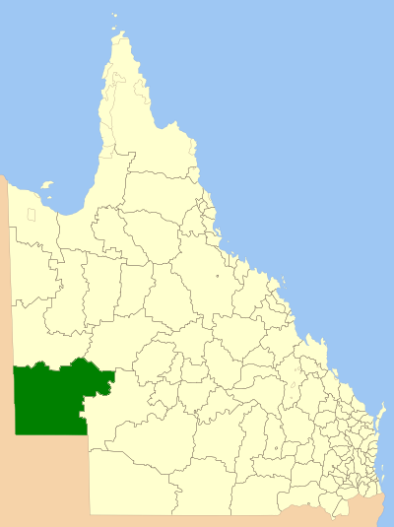
Five Remote Communities
Jundah, Stonehenge, Windorah - Barcoo Shire
Birdsville, Bedourie - Diamantina Shire

Slide 3
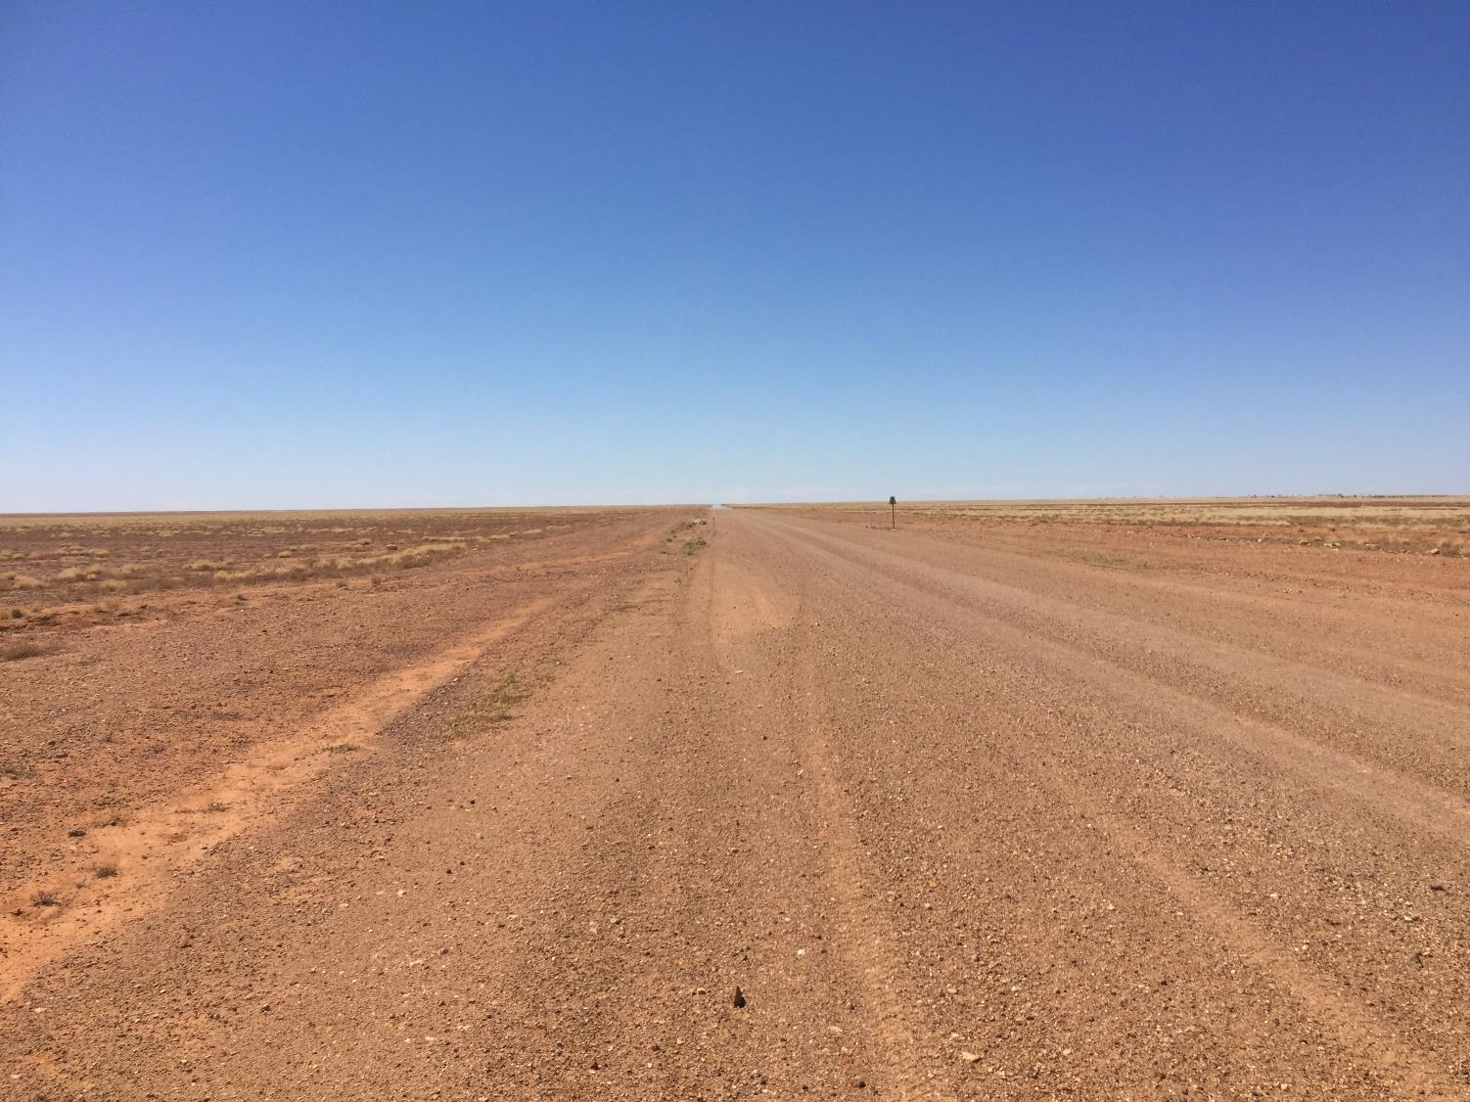

Slide 4
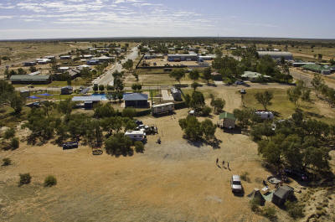
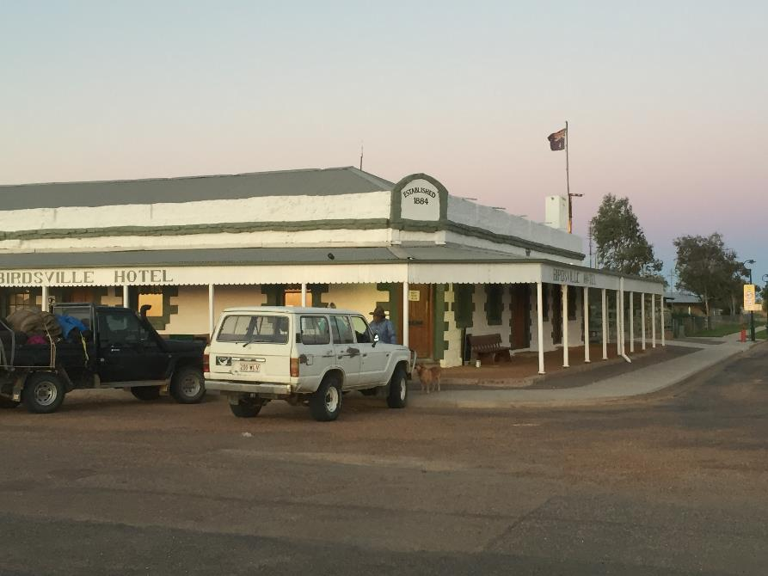

Slide 5
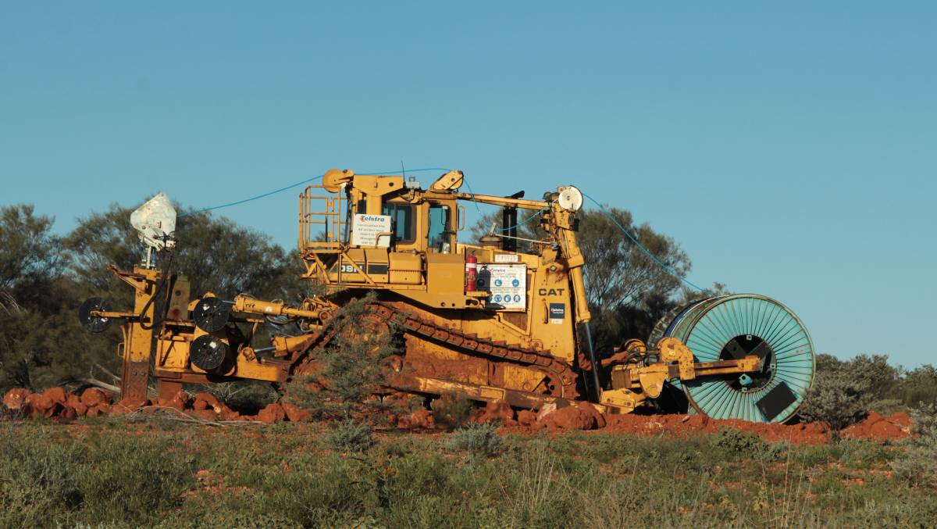
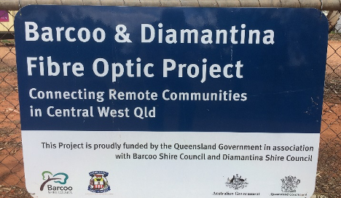

Slide 6
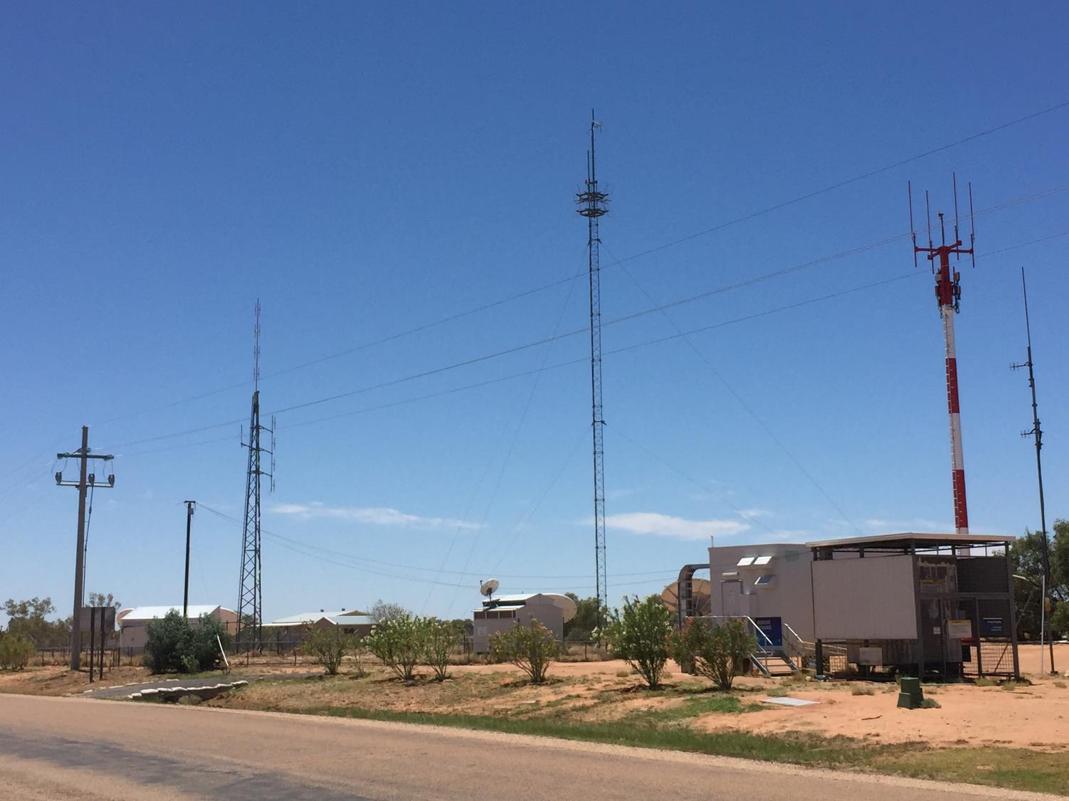

Slide 7
Baseline plus Annual Measures of Change
2016 – Baseline before connectivity
  Mobile phone data and calls – 20km radius
  Telstra Skymuster satellite service - upgraded
  Government services - “fibre to the premises”
  Business and residences - “fibre to the node”
2017 – 1 year connectivity
2019 – 2.5 years connectivity

Slide 8
Central Western Queensland Digital Connectivity Project
Face to face interviews + scores
Qualitative and quantitative analysis

Slide 9
Measures
Connection – reliability and performance
Use
Digital capacity
Voice telephony
Social Characteristics
Access to Services
Economic Characteristics
Specific business changes

Slide 10
Interviews
Community | No of Interviewees |  |  | Total
 | 2016 | 2017 | 2019
Jundah | 16 | 16 | 15 | 47
Stonehenge | 6 | 4 | 7 | 17
Windorah | 14 | 14 | 16 | 44
Bedourie | 8 | 13 | 12 | 33
Birdsville | 7 | 11 | 12 | 30
Total | 51 | 58 | 62 | 171

Slide 11
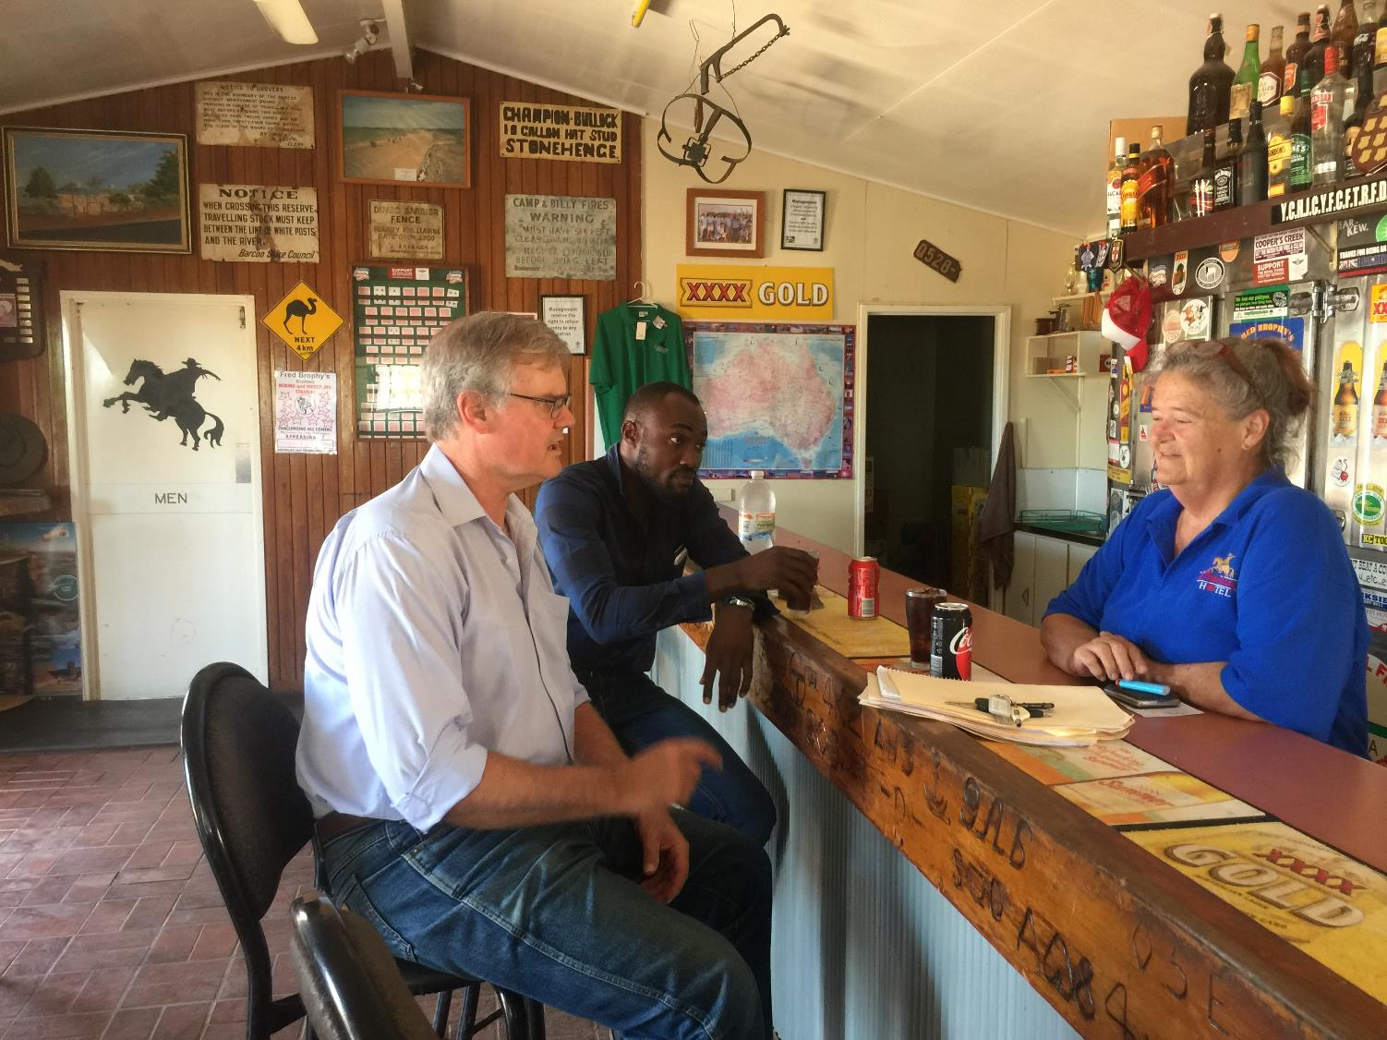

Slide 12
Key Findings
Greater digital connectivity but recent problems
Improved business efficiency but change to culture
Important for tourism
Greater social connection with face to face contact
Community organising made easier
Improved access to services
Big impacts on education
Contributor to attracting people
Benefits in emergencies

Slide 15
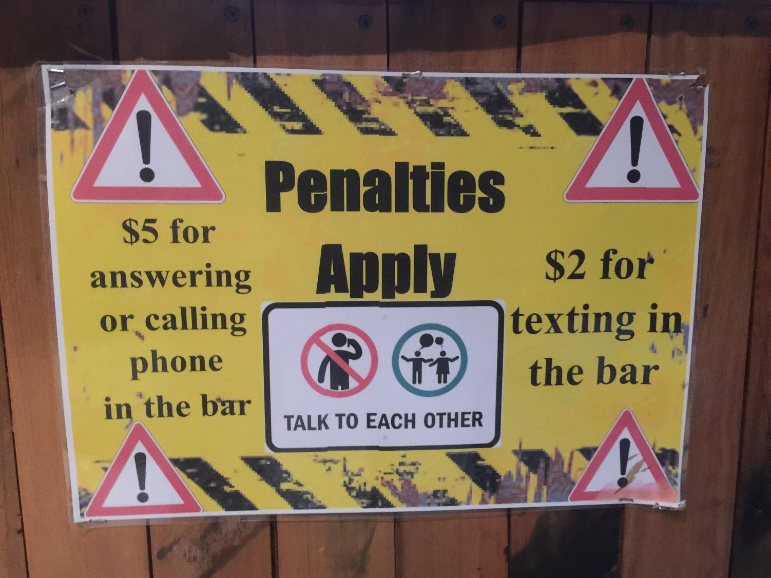

Slide 17
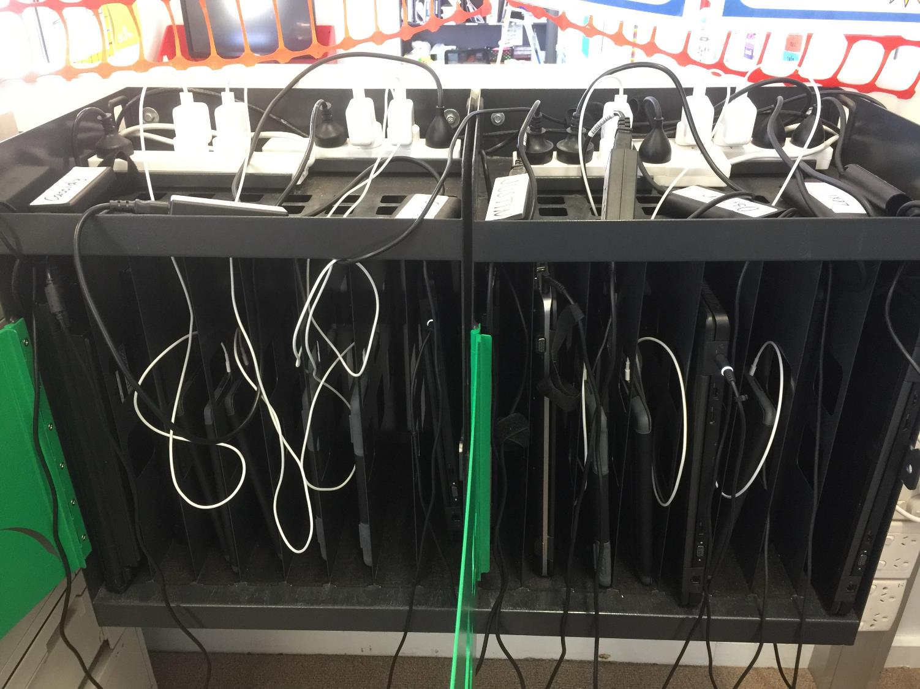

Slide 19
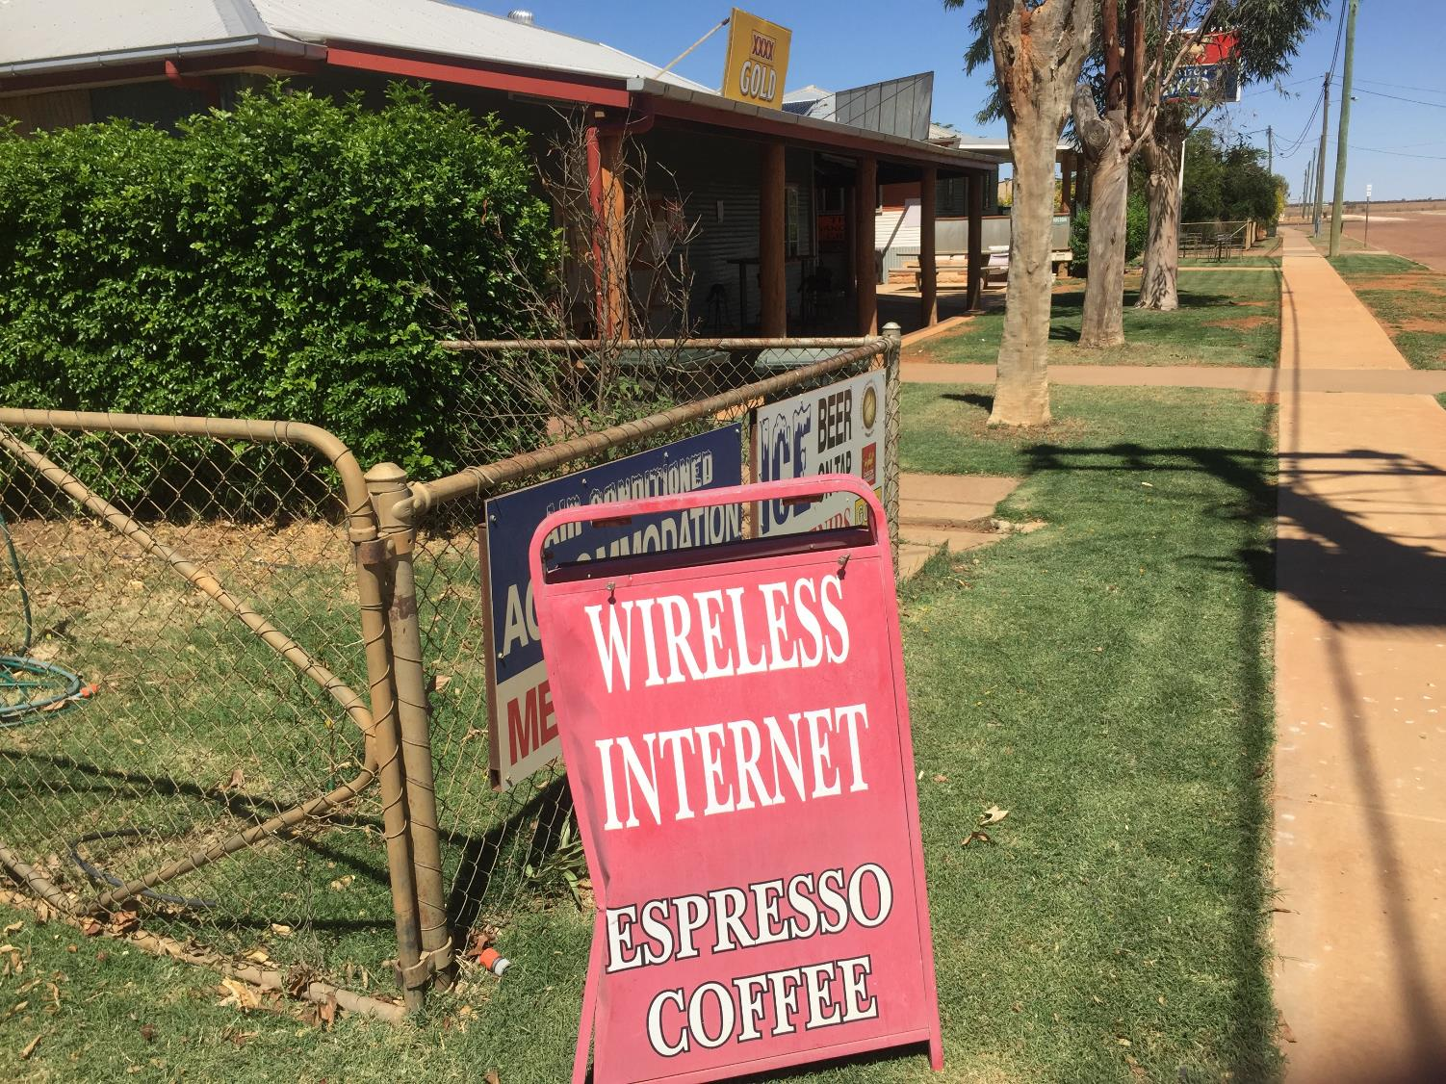

Slide 20
Issues
Business culture
Developing confidence and awareness
Supporting digital “champions”
“Choking” of speed
Recent drop in mobile coverage

